Slide 1
Advanced License Law
Continuing Education Class
WWW.CAMPBELLANDBRANNON.COM/LICENSELAW

Slide 2
Purpose of License Law
Performance and disciplinary powers to shield agents from unfair competition
Designed to protect the public from dishonest or incompetent agents
Show others that agents have knowledge and integrity to serve the public in a reliable and professional manner

Slide 3
Georgia Real Estate Commission (GREC)
Has the authority to:
Issue licenses
Set fees
Pass rules and regulations
Take disciplinary actions
Power: first passed in 1925, Georgia legislature has police powers to enact rules to protect consumers
The Georgia Real Estate Commission & Appraisers Board is the state agency charged with administering Georgia real estate license law, promulgating rules, issuing licenses, and exercising disciplinary authority as provided by law.

Slide 4
GREC Powers
A broker (the brokerage firm) is the only licensee authorized by law to enter into a contract with another person who has promised to pay the broker a fee or commission
Doesn’t have to be money! Could be exchanging one property for another
Performing the services of a broker (without being one) is a crime! That person would be guilty of a misdemeanor
GA Real Estate Commission can issue “cease and desist” orders and issue fines but not authority to send to jail.
Notes:
Power of the commission to issue, censure, revoke and suspend.
Criminal, administrative, civil violations – licensee must self report to the commission… even if you are found innocent. (where there is smoke, the commission wants to know about it)

Slide 5
GREC – GA Statute 43-40-2
Creation of commission; members; meetings; recusal for conflict of interest; removal; compensation; annual report; budget unit
Composed of six members, each who are appointed by the governor and confirmed by Senate for term of 5 years
5 members shall be licensees who are residents in the state and actively engaged in real estate business for five years
6th member is chosen for expertise in consumer affairs (no real estate experience)

Slide 6
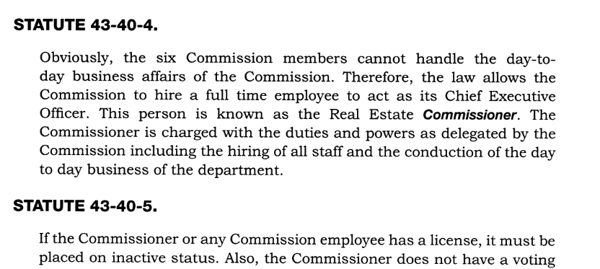
GREC – GA Statutes
Collecting fees, adopting rules and regulations, and administering licensing processes.
Operating the office of the Commission and maintaining official records.
Using an official seal and carrying out administrative and paperless processes authorized by law.
Exercising regulatory and disciplinary authority as provided in O.C.G.A. Title 43, Chapter 40.

Slide 7
Current Members
Commission
Chair: Jerry Warshaw
Vice Chair: Steve Graves
Member: Lee Dollar
Member: DeAnn Golden
Member: Cedric Matheny
Member: Brenda Thompson
Executive Staff
Real Estate Commissioner: Lynn Dempsey
Deputy Commissioner: Craig Coffee
*As of FY 2025 Annual Report

Slide 8
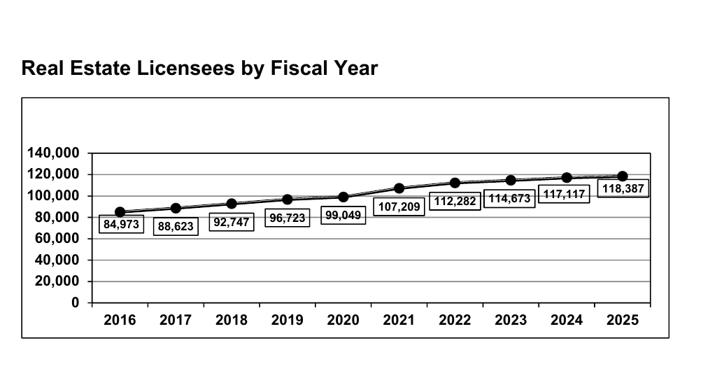
Real Estate Licensees by Fiscal Year

Slide 9
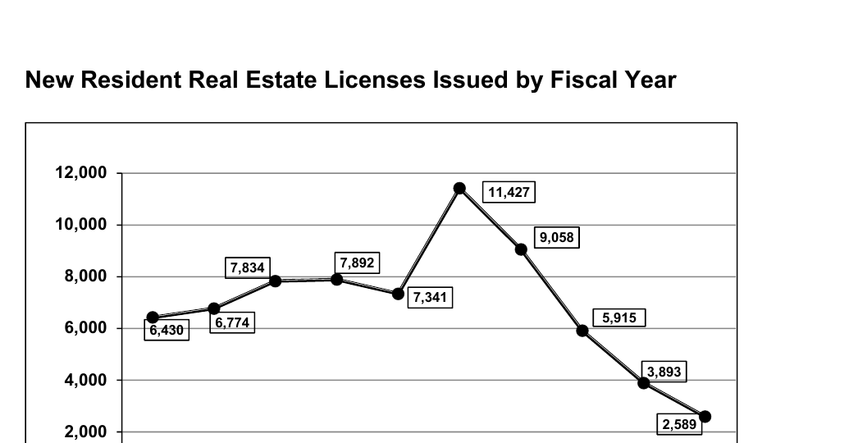
New residential Real Estate Licenses Issued

Slide 10
TYPES OF LICENSES

Slide 11
Types of Licenses: Statute 43-40-7
The Commission issues licenses to qualified (1) applicants and (2) real estate businesses.
  Applications include brokers, associate brokers, salespersons and community association managers.
  Real Estate businesses include partnerships, LLCs and Inc’s, real estate schools, and approved prelicense instructors.
  Though the application is confidential, the licensee’s name, address, phone, license held, and disciplinary record are made public.
Notes:
“Licenses shall be granted only to persons who bear a good reputation for honesty, trustworthiness, integrity, and competence to transact the business of a licensee in such a manner as to safeguard the interest of the public and only after satisfactory proof of such qualifications has been presented to the Commission.” O.C.G.A. § 43-40-15(a)
*This applies to individuals AND to any stockholder, member, or partner which owns more than a 20% interest in a Corporation, LLC, Partnership, etc.

Slide 12
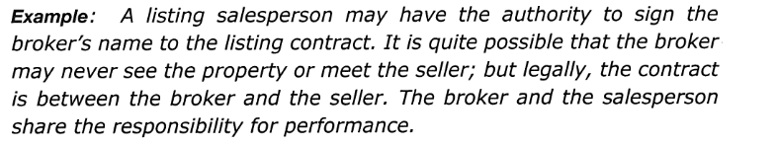
Types of Licenses: Statute 43-40-8
Broker
  May operate a brokerage firm, supervise affiliated licensees, and perform licensed brokerage activities.
Associate Broker
  Holds a broker-level license but practices through an affiliated qualifying broker unless independently qualifying a firm.
Salesperson
  Performs licensed real estate activities through the broker with whom the salesperson is affiliated.
Community Association Manager
  May perform only those acts authorized for community association management and may not perform brokerage activity outside that license classification.

Slide 13
Licensees
All licensees (unless “grandfathered”) must show at time of license renewal that they have completed the minimum continuing education hours for each year of the renewal period.
Special Note – Luckily, CE classes do not require exams!!

Slide 14
Out-of-State License: Statute 43-40-9
If Not Licensed Elsewhere:
  Would have to meet all the same requirements as a GA resident licensee (education, age, etc.)
If Licensed Elsewhere:
  Proof of license and clean disciplinary history; Payment of fees;
  Signed statement to obey rules; Affiliated with a broker;
  Appoint commission as being able to accept service on their behalf;
  Agree to assist in any investigation that may occur.

Slide 15
Requirements for Firm to be Granted a Broker’s License and Form of License
STATUTE 43-40-10
The company must name the person holding the broker’s license as the qualifying broker.
STATUTE 43-40-11
Licenses are issued under the authority of the Commission and maintained in the manner required by Georgia law and Commission rules.
Licensees should rely on the Commission’s current licensing records system for the most up-to-date form and status of licensure.

Slide 16
Fees
STATUTE 43-40-12
  Commission can charge for reasonable fees for issuance and for renewal of licenses, as well as examinations
Lapse of License –
  Can be reinstated anytime within two (2) years for a fee
  Between 2-5 years – fees + educational requirements
  >5 Years – must meet the requirements of a new licensee
STATUTE 43-40-13
  Budget of the Commission must be based on the fees collected (not provided by taxes!).

Slide 17
Inactive Licenses
STATUTE 43-40-12G and 12H
  Can go inactive at anytime, but cannot conduct any real estate business except in connection with personally owned property
Note: This is different than surrendering your license, which would instead require you to start over like a new licensee.
ISSUE, CENSURE, REVOKE and SUSPEND LICENSES
STATUTE 43-40-14
  Commission has power to ISSUE, CENSURE, REVOKE and SUSPEND LICENSES for violating the Rules and Regulations
STATUTE 43-40-15
  Defining license issues
STATUTE 43-40-16
  Applicant is entitled to a hearing and appeal if denied.

Slide 18
Prohibited Conduct: 43-40-15
Generally, the Commission will not provide a license to anyone with the following concerns:
Convicted felon (with exceptions) or crime of moral turpitude:
  Immediately notify GREC – automatic 60-day revocation unless you request hearing;
  Moral Turpitude: Bribery, perjury, fraud/forgery
Violates Fair Housing laws;
False statement on application;
  Material fact
4. Disciplinary actions by GA occupational licensing body;
  Profession with a state license (e.g. CPA, nursing) OR license lapsed/surrendered following an investigation
Failure to pay child support payments or in default of a student loan with no repayment plan in place
Notes:
-Conviction of a Crime involving Moral Turpitude
*Everything contrary to justice, honesty, modesty or good morals (i.e. fraud, false pretenses in obtaining something of value, larceny or theft by taking, murder, soliciting for prostitutes, voluntary manslaughter, sale of illegal drugs, pattern of failure to file tax returns, criminal issuance of a bad check, making a false report of a crime)
-Conviction of a Felony
*A crime punishable by imprisonment for more than twelve months
-Discipline by any legally constituted regulatory agency for violating a law regulating the sale of real estate
-Violation of the Federal Fair Housing Law or Article 4 of Chapter 3 of Title 8 of the Official Code of Georgia Annotated
*Title VIII of the Civil Rights Act of 1968 (Fair Housing Act), as amended, prohibits discrimination in the sale, rental, and financing of dwellings, and in other housing-related transactions, based on race, color, national origin, religion, sex, familial status (including children under the age of 18 living with parents or legal custodians, pregnant women, and people securing custody of children under the age of 18), and disability.
-Making a False Statement of Material Fact on an application to the Georgia Real Estate Commission
*Where an applicant or licensee has been found to be a borrower in default who is not in satisfactory repayment status, such status shall be sufficient grounds for refusal of a license or suspension
AFTER A CONVICTION, a person becomes eligible to become an applicant for a license upon completion of all terms and conditions of any sentence imposed for such conviction AND two years have passed since satisfying such terms (if single conviction) or five years have passed (if multiple convictions) or ten years have passed (if application as for an associate broker or a broker
*AND no pending charges
*AND can present satisfactory proof that the person now bears a good reputation for honesty, trustworthiness, integrity, and competence to transact the business of a licensee in such a manner as to safeguard the interest of the public

Slide 19
MANAGEMENT OF A FIRM

Slide 20
Statute 43-40-18
The qualifying broker is responsible for the supervision of affiliated licensees and may face disciplinary exposure when violations occur through inadequate supervision, participation, ratification, or failure to act as required by law and rule.
UNLESS! The Broker may not be responsible if:
There was reasonable supervision;
The Broker did not have anything to do with the infraction; and
The Broker did not ratify the infraction (i.e., cover up!).
Broker responsibilities include but are not limited to:
Review advertising for legal compliance,
Provide training programs on the Rules & Regulations and License Law,
Review all contracts within 30 days of the date of offer or contract,
Review trust account procedures and make proper withdrawals,
Ensure only licensees perform acts that require licensure,
Safe keeping of all records,
Give all licensees a written policies and procedures manual,
Make all licensees sign written affiliation contracts regarding compensation, and
Have managerial authority reasonably available.
Notes:
Management Responsibilities of Real Estate Firms:
Broker shall not conduct business under any name other than the one in which the broker’s license is issued
Broker shall be held responsible for any licensee whose license is affiliated with the broker
Broker shall be responsible to instruct licensees affiliated with the broker of the provisions set forth in the License Law and its Rules and Regulations
Broker shall notify GA Real Estate Commission of any violation of the License Law and its Rules and Regulations

Slide 21
Statute 43-40-19
WHAT HAPPENS WHEN YOU MOVE BROKERAGES DURING A TRANSACTION???
Generally, a licensee can only act on behalf of one broker at a time. However, that licensee might be allowed to continue to work for and be paid by the former broker if:
  Both Brokers agree in writing; See GAR Form C013
  The specific transaction(s) are identified;
  The former broker agrees to take full responsibility; and
  The agreement states how the licensee will be compensated by the former broker (i.e. Affiliation Agreement).
NOTE: When your license is released from the prior brokerage, you may not engage in activities of a licensee until you deliver a signed GREC change form
Notes:
Broker Must Release your License
When an affiliated licensee leaves a broker for whom such licensee is acting, the broker shall immediately send the license to the Commission OR to the new broker for whom the licensee is transferring to (and the old broker shall notify the Commission that the license was sent to the new broker). If sent directly to the Commission, must also send a release signed by both parties OR a copy of a letter from the broker mailed to the licensee’s last known address indicating that the broker is returning the license to the Commission
When can you resume business activities?
The licensee shall not engage in business activities until:
application to transfer the license to the new broker is submitted to Commission OR
licensee receives authorization from the Commission

Slide 22
Statute 43-40-19
WHAT HAPPENS TO PENDING PURCHASE AND SALE AGREEMENTS, COMMISSIONS AND EXISTING BROKERAGE AGREEMENTS?
  GREC 520.01.07: ICA must include compensation terms for during affiliation, and on transactions started prior to you leaving. This defines your compensation.
  All contracts are written in your Broker’s name. Thus, pending contracts stay with FORMER.
    Many brokers will release existing brokerage agreements to new broker.
    You would need to sign a termination with FORMER brokerage and sign a new brokerage agreement with NEW brokerage IN ADDITION to transferring FMLS.
  Commission- Permission needed from NEW broker for FORMER broker to pay you. Otherwise- FORMER broker would pay the commission to NEW Broker and new broker pays you according to your new ICA.
NOTE: Please notify closing attorney ASAP. We need confirmation from the brokers regarding your agreement for payment of commission.
Notes:
When a licensee requests that a release form be signed, the releasing broker shall immediately sign the release and forward the wall certificate of licensure to the Commission/to the new broker
All plats of property, keys, and other property which the releasing broker owns or for which the releasing broker is responsible, “for sale” signs, notebooks, listing cards, or records of any kind shall be returned in person by the departing licensee to the person designated by the releasing broker

Slide 23
When You Leave a Brokerage
Forms:
  When you leave a brokerage, you must complete a GREC change form. The broker then releases your license.
  If you are not joining another brokerage right away, you have 30 days to notify GREC that you want to be inactive ($25 fine)
  Keep GREC advised of your info: name change and address change form ($25 fine)
Notes:
Should a broker change the address of the broker’s place of business, the broker shall notify the Commission, in writing, within 30 days of such change

Slide 24
TRUST ACCOUNTS

Slide 25
What is a Trust Account?
An account in trust or trust account refers to any type of financial account that is opened by an individual and managed by a designated trustee for the benefit of a third party in accordance with agreed-upon terms.
There may be multiple trust accounts;
All trust accounts must be disclosed to the Commission within 30 days;
Regular audits are required (or CPA report);
Notes:
GREC 520-1-.08 – this section is so serious it is 6 printed pages long!
Each broker who accepts down payments, earnest money deposits, security deposits, rents, association fees, or other trust funds in a real estate brokerage transaction OR whose affiliated licensees accept such trust funds shall maintain a separate, federally insured account at a financial institution in this state
By law, the broker MUST report licensee to the commission of any violations that have been committed (e.g., failure to deliver EM deposit on time) – failure to report, may result in both the broker and licensee going down due to repeat offender/pattern of behavior that has not been properly documented.
Funds MUST be deposited promptly – a salesperson CANNOT hold funds.
Brokers job is not only to protect the individual licensee but ALL licensee under the brokerage firm – this requires consistency in behavior to avoid discriminatory practices.
Everything is time stamped in the banking industry… MUST be truthful because the paper trail is going to reveal the truth.
Brokers account MUST be a “TRUST” Account designation.

Slide 26
Trust Accounts
Statute 43-40-20
Trust account required when handling client funds.
Statute 43-40-21
If funds are accepted, the Broker has 1 business day to establish a trust account (FDIC insured).
GREC 520-1-.08(1b): When should Licensee forward EM to the broker? As soon after receipt as practically possible.

Slide 27
Trust Accounts: Frequently Asked Questions
Who gets the interest?
  The Broker
Can EM be paid by personal check?
  In most cases, YES. Most escrow holders have check policies in place.
  You must have “good funds” before you can disburse the funds!
    Consider: Termination prior to check clearing
    Check with the brokerage (or closing attorney)
    In most cases: Wire or ACH
Can a buyer’s EM automatically be moved from one contract to another if buyer terminates and goes under contract right away?
  Yes, but must have written authorization from the parties.

Slide 28
When Should a Broker Disburse Trust Funds?
Upon the rejection of an offer to buy, sell, rent, lease, exchange, or option real estate
Upon the withdrawal of an offer not yet accepted
At the closing of the transaction
Upon securing a written agreement which is signed by all parties having an interest in the trust funds and is separate from the contract which directs the broker to hold the funds
Upon the filing of an interpleader action in a court of competent jurisdiction
Upon the order of a court of competent jurisdiction; OR
Upon the reasonable interpretation of the contract which directed the broker to deposit the funds
Notes:
Page 16 O.C.G.A. 520-1-08 (3)(a)-(b)
A broker who disburses trust funds from the broker’s designated trust/escrow account contrary to the terms of a contract will be considered by the Commission to have demonstrated incompetence to act as a real estate broker in such manner as to safeguard the interest of the public.

Slide 29
Dispute Over Disbursement
10 DAY LETTER:
Step 1: Broker makes reasonable interpretation of contract.
  Why did it not close?
  Did a party terminate under a contingency or during due diligence?
  Is someone in default?
Step 2: Broker sends letter and the party who is not receiving the funds has 10 days to object.
  Maybe there was information/amendment not provided to Broker.
Step 3: If no objection- the Broker can disburse pursuant to the 10 Day Letter.

Slide 30
Dispute Over Disbursement
Interpleader Action:
What is Interpleader?
When a real estate broker holds trust funds (like earnest money) and there’s a dispute over who should get the money, the broker can ask the court to decide—this is called an interpleader action.
Why Use Interpleader?
It protects brokers from being caught in the middle of a dispute and from being sued by either party over the funds.
How Does It Work?
The broker files paperwork with the court, deposits the disputed money, and lets the court decide who gets it.

Slide 31
Trust Funds – Your Property – Extra Rules
When pertaining to the property of the licensee:
  Must deposit all earnest money or security deposits into the broker’s trust account or one approved by the Broker and register with the Commission;
  Required to provide Broker quarterly reconciliation of trust account;
GREC 520.1.08(4c): If licensee owns 100% of property (no spouse, no LLC, etc.)- must hold in trust and no bond in lieu.
In the event there appears to be a violation of these trust account rules, the Attorney General may impound the account or issue an injunction to appoint a receiver.

Slide 32
EDUCATION, RESEARCH & RECOVERY FUND

Slide 33
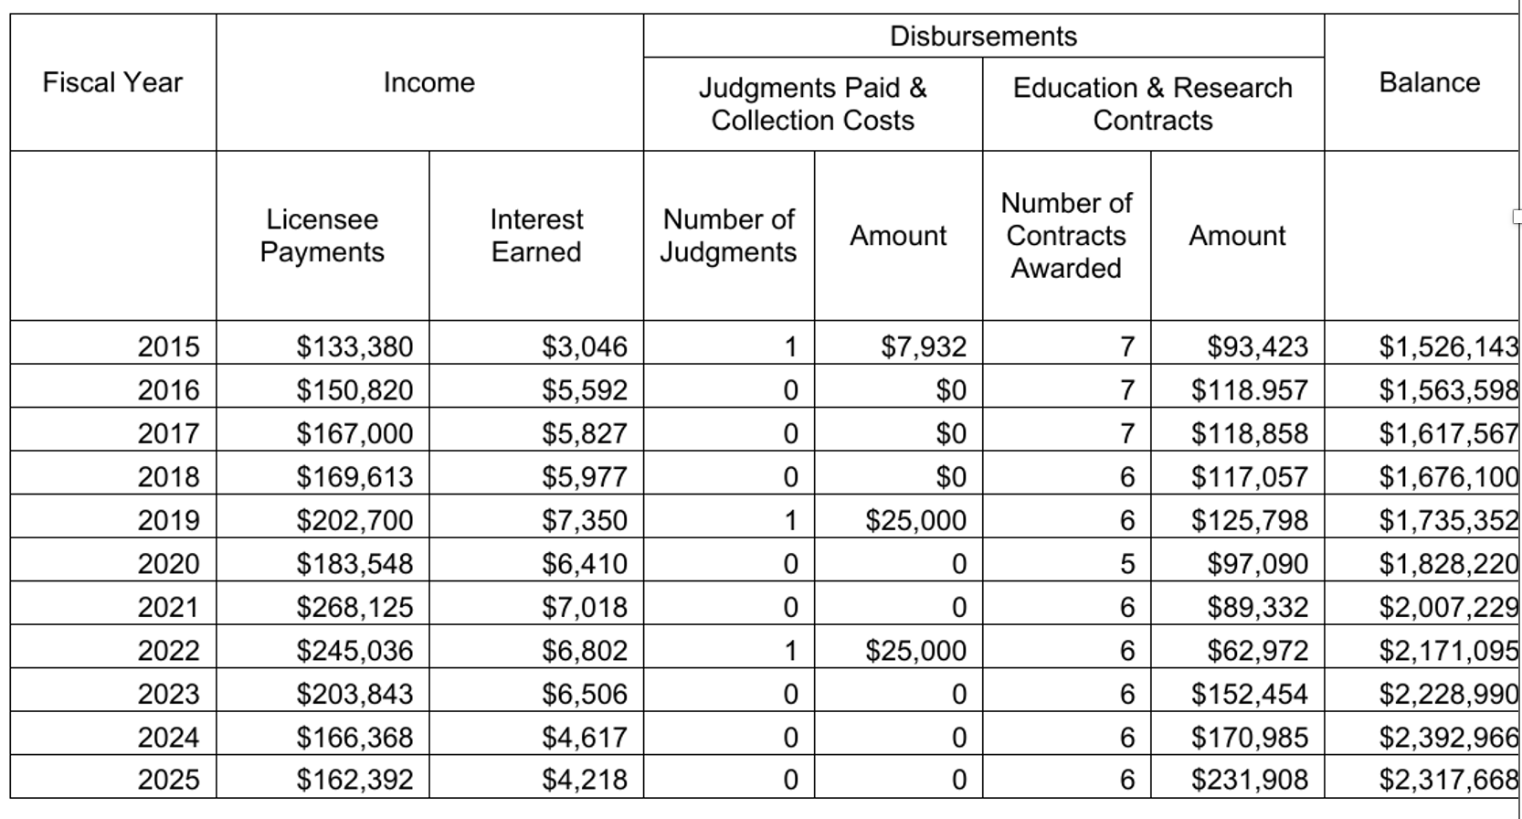
Education, Research & Recovery Fund
STATUTE 43-40-20
WHAT IS IT: Special fund held in trust by GREC.
FUNDING: a one-time $20.00 fee for each original real estate license issued and any interest earned in the fund.

Slide 34
Education, Research & Recovery Fund
STATUTE 43-40-20
USE OF FUNDS:
  to reimburse non-licensees who have been harmed by a licensee but cannot recover from the licensee after obtaining a judgment against the licensee through the courts
  to underwrite the cost of developing real estate courses, conducting real estate seminars, conducting real estate research projects, publishing and distributing real estate educational material, and for education research programs for the benefit of real estate licensees and the public.

Slide 35
VIOLATIONS & UNFAIR PRACTICES

Slide 36
Licensees shall not engage in any of the following unfair trade practices: OCGA 43-40-25b
(1) Because of race, color, religion, sex, disability, familial status, or national origin:
  Refusing to sell/rent after the making of a bona fide offer, or refusing to negotiate for the sale or rental of, or otherwise making unavailable or denying real estate to any person
  Discriminating against any person in the terms, conditions, or privileges of sale or rental of real estate or in the provision of services or facilities in connection therewith
  Making, printing or publishing any advertisement that indicates any preference, limitation, or discrimination
  Representing to any person that any real estate is not available for inspection, sale, or rental which such real estate is in fact so available; or
  Representing explicitly or implicitly that a change has or will or may occur in a block, neighborhood, or area in order to induce or discourage the listing, purchasing, selling or renting of real estate

Slide 37
Licensees shall not engage in any of the following unfair trade practices: OCGA 43-40-25b
(2) Intentionally advertising material which is misleading or inaccurate or which in any way misrepresents any property, terms, values, policies, or services of the business conducted;
(3) Failing to account for and remit money coming into the licensee’s possession;
(4) Comingling money/property of the licensee’s principles;
(5) Failing to maintain and deposit in a separate bank account all money received as escrow agent/temporary custodian unless all parties have agreed in writing

Slide 38
Licensees shall not engage in any of the following unfair trade practices: OCGA 43-40-25b
(6) Failing to disclose in writing to a principal in a real estate transaction any of the following:
  The receipt of a fee, rebate, or other thing of value on expenditures made on behalf of the principal for which the principal is reimbursing the licensee;
  The payment to another broker of a Commission or fee for a referral
  The receipt of anything of value for the referral of any service or product in a real estate transaction to a principal

Slide 39
Licensees shall not engage in any of the following unfair trade practices: OCGA 43-40-25b
(7) Representing a real estate broker, other than the broker holding the licensee’s license, without the express knowledge and consent of the broker holding the licensee’s license
(8) Accepting a Commission by a licensee from anyone other than the broker holding that licensee’s license without the consent of that broker
(9) Acting in the dual capacity of agent and undisclosed principal in any transaction
(10) Guaranteeing future profits which may result from the resale of property

Slide 40
Licensees shall not engage in any of the following unfair trade practices: OCGA 43-40-25b
(11) Placing a for sale/for rent sign on property without the written consent of the owner and failing to remove the sign within ten days after the expiration of listing
(12) Offering real estate for sale/lease without the knowledge and consent of the owner or on terms other than those authorized by the owner
(13) Inducing any party to a contract of sale/lease or to a brokerage agreement to break such contract in order to substitute another contract

Slide 41
Licensees shall not engage in any of the following unfair trade practices: OCGA 43-40-25b
(14) Negotiating a sale, exchange, or lease directly with an owner, a lessor, a purchaser, or a tenant if the licensee knows that such person has a written contract in connection with such property
(15) Indicating that an opinion given to a potential seller, purchaser, landlord, or tenant is an appraisal unless such licensee holds an appraiser classification
(16) Performing any of the acts of a licensee on property located in another state without being properly licensed in that state

Slide 42
Licensees shall not engage in any of the following unfair trade practices: OCGA 43-40-25b
(17) Paying a Commission to any person for performing the services of a real estate licensee who is not licensed
(18) Failing to include a fixed expiration date in any written listing agreement and failing to leave a copy of said agreement with the principal
(19) Failing to deliver within a reasonable time a completed copy of any purchase agreement or offer to buy or sell real estate to the purchaser and seller
(20) Failure by a broker to deliver to the seller a closing statement showing all of the receipts/disbursements handled by such broker for the seller or failure to deliver to the buyer a complete statement showing all money received in said transaction

Slide 43
Licensees shall not engage in any of the following unfair trade practices: OCGA 43-40-25b
(21) Making any substantial misrepresentations
(22) Acting for more than one party in a transaction without express written consent of all parties
(23) Failure of an associate broker or salesperson to place in the custody of the broker holding their license any deposit money or other money entrusted to the licensee
(24) Filing a listing contract or any document or instrument purporting to create a lien based on a listing contract for the purpose of casting a cloud upon the title to real estate when no valid claim under said listing contract exists

Slide 44
Licensees shall not engage in any of the following unfair trade practices: OCGA 43-40-25b
(25) Having demonstrated incompetency to act as a real estate licensee in such a manner as to safeguard the interest of the public or any other conduct which constitutes dishonest dealing
(26) Obtaining a brokerage agreement, sales contract, or lease while knowing that another broker has an exclusive brokerage agreement with said person unless obtaining written permission from the first broker
(27) Failing to keep for a period of three years a true and correct copy of all sales contracts, closing statements, any offer or other document that resulted in the depositing of trust funds, accounting records required, and other documents relating to real estate closing transactions
Notes:
25) It is difficult to specifically define what is required to be competent. However, in order to provide competent service, the licensee is expected to 1) use good judgment, 2) obtain training appropriate to the task, and 3) seek the advice of his/her broker. Usually, an individual recognizes when he/she is reaching beyond his/her competence level in a transaction, or in providing advice. If that is the case, it is best to seek the advice of the broker or an expert in the matter of concern. The real estate licensee can obtain needed training by pursuing specialized designations, focusing continuing education on specific specialties, and gaining experience through cooperation and assistance with other licensees experienced in that field.
27) Also need to dispose of the files properly. The Disposal Rule requires disposal practices that are reasonable and appropriate to prevent the unauthorized access to – or use of – information in a consumer report. For example, reasonable measures for disposing of consumer report information could include establishing and complying with policies to: • burn, pulverize, or shred papers containing consumer report information so that the information cannot be read or reconstructed; • destroy or erase electronic files or media containing consumer report information so that the information cannot be read or reconstructed; • conduct due diligence and hire a document destruction contractor to dispose of material specifically identified as consumer report information consistent with the Rule. Due diligence could include: • reviewing an independent audit of a disposal company’s operations and/or its compliance with the Rule; • obtaining information about the disposal company from several references; • requiring that the disposal company be certified by a recognized trade association; • reviewing and evaluating the disposal company’s information security policies or procedures.” https://www.ftc.gov/tips-advice/business-center/guidance/disposingconsumer-report-information-rule-tells-how

Slide 45
Licensees shall not engage in any of the following unfair trade practices: OCGA 43-40-25b
(28) Being a party to any falsification of any contract or other document
(29) Failing to obtain the written agreement of the parties indicating to whom the broker shall pay any interest earned on trust funds deposited into an interest-bearing account
(30) Failing to disclose in a timely manner any agency relationship that the licensee may have with any of the parties
(31) Attempting to perform any act authorized by this chapter to be performed only by a broker, associate broker, or salesperson while licensed as a community associate manager

Slide 46
Licensees shall not engage in any of the following unfair trade practices: OCGA 43-40-25b
(32) Attempting to sell, lease, or exchange the property of any member of a community association to which a licensee is providing community association management services without the express written consent of that association
(33) Failure to deliver to a community association terminating a management contract within 30 days of the termination, or within such other time period as the management shall provide: (a) complete record of all transactions and funds handled (b) all records and documents received on the association’s behalf (c) any funds held
(34) Failure to deliver to a property owner terminating a management contract within 30 days of the termination, or within such other time period as the contract shall provide: (a) complete record of all transactions and funds handled (b) all records and documents received on the owner’s behalf (c) any funds held

Slide 47
Licensees shall not engage in any of the following unfair trade practices: OCGA 43-40-25b
(35) Inducing any person to change another licensee’s fee or Commission for real estate brokerage services without that licensee’s consent
(36) Failing to obtain a person’s written agreement to refer that person to another licensed broker for brokerage or relocation services and to inform such person being referred whether or not the licensee will receive a valuable consideration for such referral
  NOTE: GAR C016 Broker to Broker form GAR F843 Prospect’s Acknowledgement and Consent to Referral

Slide 48
Brokerage Relationship

Slide 49
Brokerage Relationships
Each exclusive brokerage agreement must fully set forth its terms and have a definite expiration date GREC 520-1-.06(1)
At the time of securing a brokerage engagement, the licensee securing it must furnish each person signing it a true copy thereof GREC 520-1-.06(1)
The Commission prohibits the acceptance by brokers of net brokerage engagements and hereby makes it obligatory upon the broker, when securing the brokerage engagement, to add the broker’s fee thereby notifying the client of the gross price of the property and the broker’s services GREC 520-1-.06(1)
  The fees to be paid have to be established at the time of signing.
Notes:
In a net listing, the owner establishes a minimum amount that he or she wants to receive from the sale of the property and allows the broker to keep any amount above the minimum as a commission. While the seller gets what he or she wants for the sale, in this case, it creates a conflict of interest for the broker by violating the broker’s fiduciary responsibility to put the client’s interests ahead of his or her own.

Slide 50
Brokerage Relationships
No licensee shall buy or lease, nor take an option to buy or lease, any interest in property listed with the licensee/licensee’s firm acting as broker unless the licensee clearly discloses the licensee’s position as a buyer to the seller or as a tenant to the landlord, and inserts a clause to that effect in the contract. Same requirements for a licensee selling property owned by the licensee. GREC 520-1.06(4a)
    “Purchaser is a duly licensed agent in Georgia, RE
    License #___.”
A licensee shall make a written disclosure to buyer/seller or lessor/lessee revealing the party/parties for whom that licensee’s firm is acting as agent or dual agent and from whom that licensee’s firm will receive any valuable consideration for its efforts as agent. Must disclose no later than the time that any party first makes an offer. GREC 520-1.06(4b)
Real estate licensees shall not pay a fee or Commission to a licensee representing another party to a transaction except with the full knowledge and written consent of all parties. GREC 520-1.06(4c)

Slide 51
Brokerage Relationships: Support Personnel
Support personnel may only handle ministerial duties- those that do not require discretion or judgment- unless support personnel holds a real estate license. GREC 520-1.07(6a)
Individual licensed with one firm may work as support for a different firm with permission from both brokers. You can also work as support personnel when your license is inactive. GREC 520-1.07(6c)
Need broker permission to hire support personnel and contract signed. GREC 520-1.07(6d)

Slide 52
Brokerage Relationships: Support Personnel Tasks
Answer phone/forward calls
Submit data to MLS
Check status of loans on files under contract
Assemble closing documents
Obtain documents that are public information
Have keys made and install/remove lock boxes
Write ads/promotional materials (to be approved by broker)
Place ads in magazines/media at broker’s request.
Receive, record and deposit EM.
Type contract forms- must be directed by broker/licensee.
Monitor personnel files
Compute commission checks
Place/remove signs at properties
Order routine repair items at direction of licensee
Act a courier (for keys, etc.)
Schedule listing appts
Arrange inspections
Arrange mortgage applications/walk through/closing times
Schedule open house
Accompany licensee to open house or showing (for security)
Perform physical maintenance on the property.
Notes:
Support personnel may NOT
make cold calls, host open houses, prepare promotional materials without the review and approval of a licensee, show real estate, answer questions on title, financing, or closings (other than time and place), answer questions on a listing except for info on price and amenities expressly authorized in writing by the licensee, explain a contract, listing, agreement, lease, negotiate or agree to any Commission, discuss the attributes or amenities of real estate, discuss with owners the terms and conditions of the real estate offered for sale, collect/hold deposit monies, rent, other monies from owner of real estate or from prospective purchaser, provide owners/prospective purchases with advise as to the sale/purchase

Slide 53
ADVERTISING

Slide 54
Advertising
Rule 520-1-.09 (7) Provides the specific requirements for advertisements of any real estate for sale, rent, or exchange in any media:
  name and telephone number of the licensed firm must be included
  name of firm shall appear in equal or greater size, prominence, and frequency than the name of any affiliated licensee
  firm's telephone number shall appear in equal or greater size, prominence, and frequency than the telephone number of any affiliated licensee, and it must be a number at which the public can reach the broker or a manager without going through the affiliated licensee(s) listed in the advertisement

Slide 55
Advertising
Every viewable web page of a website must disclose the name and telephone number of the licensee’s firm, except:
  when advertising electronic messages of limited info/characters, you may provide a direct link to a display in compliance with this requirement - One click away.
*Note: You are not responsible for information that is taken without your consent from your website and placed on another website that is out of your control

Slide 56
Advertising
Any advertising that is misleading or inaccurate in any material fact or in any way misrepresents any real estate is prohibited
A licensee shall not advertise until the licensee has first secured the written permission of the owner
A licensee shall not use an advertisement that is directed at or referred to persons of a particular race, color, religion, sex, handicap, familial status, or national origin

Slide 57
HANDLING REAL ESTATE TRANSACTIONS

Slide 58
Handling Real Estate Transactions
A licensee shall promptly tender to any client any signed offer to purchase, sell, lease, or exchange property made to such client. GREC 520-1.10(1)
    Doesn’t matter what form it is on! Can you require a GAR form?
A licensee preparing or signing a brokerage engagement or an offer to purchase, sell, lease, or exchange real property shall include the license number issued by the Commission of each firm and of each licensee participating in the transaction. GREC 520-1.10(2) *Watch non-GAR forms*
A licensee shall provide a copy of any document utilized in a real estate transaction to any individual signing such document. GREC 520-1.10(3)
If an offer is accepted and signed by all parties, copies shall be properly distributed, one to each party signing and one to each brokerage firm involved. GREC 520-1.10(3)
Copies of sales contracts, brokerage engagements, closing statements, and leases must be maintained in a broker’s file for three years and shall be made available to authorized agents of the Commission upon reasonable request GREC 520-1.10(4)

Slide 59
Falsification of Documents & Misleading Representations
No Licensee shall falsify a document involved in a real estate transaction or knowingly represent to a principal:
  An amount other than the true and actual price
  An amount other than the true and actual down payment
  An amount other than the true and actual earnest money
  A payment of trust funds in cash when in fact some other method is made; or
  An artifice with the intent to deceive
GREC 520-1.10(5)

Slide 60
Disclosure of Commission
Disclosure of Commission must be made in advance of the payment or receipt of a Commission. GREC 520-1.10(6a)
In a transaction where a licensee refers a principal to another broker for service, the payment of a Commission by the broker working with the principal shall be disclosed in writing to the principal by the broker to whom the referral was made no later than at the closing. GREC 520-1.10(6b) (Use proper forms.
The disclosure for requirement for referral fees is in addition to requirements under RESPA. GREC 520-1.10(6c)
Unfair trade practices- Licensee’s Principal includes both clients and customers (without buyer brokerage agreement). GREC 520-1.10(6d)
Rebates are OKAY but must be shown on settlement statement and paid through the closing and must not mislead the other side. GREC 520-1.10(6e)
Closing gifts are OKAY but cannot be contingent on closing. GREC 520-1.10(6)

Slide 61
Licensee of Principal: 43-40-29(c)
A licensee must comply with the required provisions whether acting as an agent or as a principal.
Brokers must monitor the activities of agents in their own transactions.
  What about properties in other states?
GREC Rules apply only to properties in the State of Georgia. So, no set rules for property owned by licensee in another state.

Slide 62
When a Licensee Offers to Purchase
Offers to Buy Associated with a Brokerage Relationship
Whenever a licensee offers to purchase a property as a condition to obtaining a brokerage engagement or on which the licensee is extending the expiration date of an existing brokerage engagement, the licensee must enter into a written contract to purchase which expresses all the terms and conditions of the licensee’s purchase prior to or at the time of entering into the proposed brokerage engagement or into the extension of the existing brokerage engagement
Whenever a licensee offers to purchase a property in order to enable a party to purchase, sell, lease, or exchange another property, the licensee must enter into a written contract to purchase which expresses all the terms and conditions of the licensee’s purchase prior to or at the time of the other party’s entering into a contract to purchase, sell, lease, or exchange the new property

Slide 63
FAIR HOUSING & CITATIONS

Slide 64
Fair Housing & Citations
Federal Fair Housing Act Protections
Race
Color
Religion
Sex
National Origin
Familial Status
Disability
Best Practice / Risk Management Consideration
HUD has interpreted and enforced sex-discrimination protections to include sexual orientation and gender identity. Georgia licensees should also consider applicable local ordinances and adopt advertising and brokerage practices that avoid exclusionary targeting or messaging.
Notes:
A THREE-YEAR NEWSDAY INVESTIGATION UNCOVERED WIDESPREAD EVIDENCE OF UNEQUAL TREATMENT BY REAL ESTATE AGENTS ON LONG ISLAND
https://projects.newsday.com/long-island/real-estate-agents-investigation/
25 undercover testers trained
93 real estate agents tested
240 hours of meetings secretly recorded
5,736 house listings analyzed
19% of the time against ASIANS
39% of the time against HISPANICS
49% of the time against BLACKS

Slide 65
Fair Housing Best Practices
Focus on the property and its amenities, not on your “ideal” buyer or renter.
Do not make statements that have the effect of excluding individuals of a protected class from your advertising initiative.
Avoid restricting your advertisements from only reaching certain individuals or audiences by, for example, using platform features that allow advertisers to restrict who sees the advertisements based on certain characteristics like race, religion or age.
If you use pictures of people in your advertisements, make sure the advertisement includes individuals reflective of the population in the area where the advertisement is placed.
Include the phrase “Equal Housing Opportunity” or the fair housing logo in your advertisements.
  Not required- check with your Broker.

Slide 66
Fair Housing Act - Violations
Example from HUD.gov
Example: John, who is an Asian man, meets with a real estate broker to discuss purchasing a house for his family. When John names the neighborhood that he is interested in, the broker asks John if he is sure that his family will feel comfortable there. The broker tells John that she has a wonderful listing in another neighborhood where there are more “people like them.” When the broker takes John to see the house, John notices that the residents of the neighborhood appear to be mostly Asian. John files a complaint with HUD because steering someone to a certain neighborhood because of his race is a form of race discrimination.

Slide 67
Fair Housing Act: Problematic Statements - NAR
“Ideal for a single professional” or “perfect apartment for a student.”
  Discriminates against couples, single parents, seniors.
“No pets.”
  Discriminates against people with disabilities who use service animals.
“Not soundproof.”
  Shows preference for tenants without children.
Other statements that show preference to certain classes of people include:
  “Great for students or working folks.”
  “Suitable for a mature couple or individual.”
  “Perfect for a female student.”
  “Suits a single professional.”
  “Ideal for a quiet couple.”

Slide 68
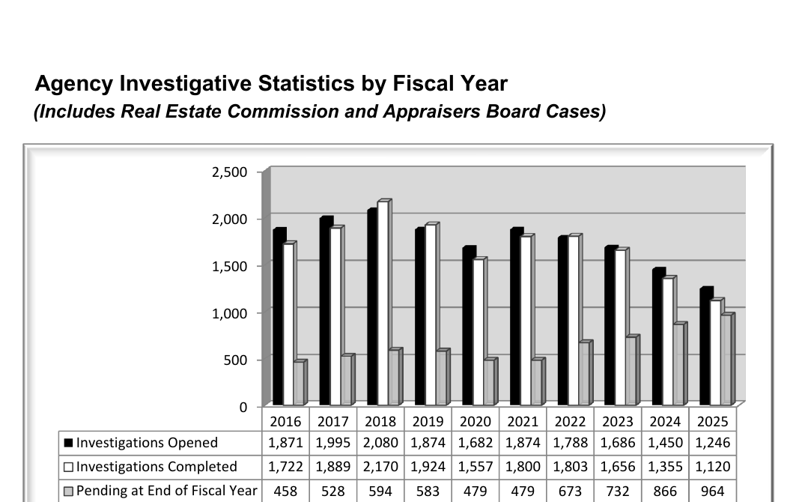
Agency Investigative Statistics by Fiscal Year
Notes:
GREC reports annual investigations activities and the outcomes of those investigations.

Slide 69
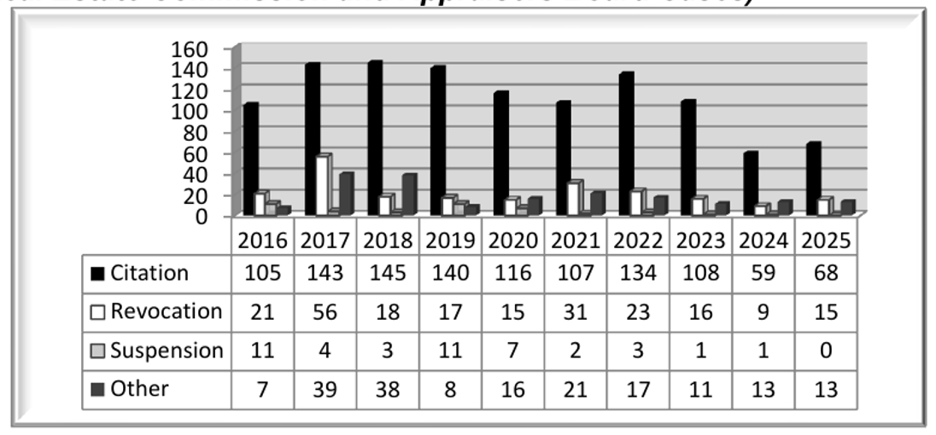
Agency Disciplinary Actions Imposed by Fiscal Year
Notes:
Not only may the Commission refuse, suspend, or revoke a license for the offenses discussed previously, the Commission may also impose sanctions
Refuse to grant or renew a license to an applicant
Administer a reprimand
Suspend any license for a definite period of time OR an indefinite period of time
Revoke any license or approval
Revoke the license of a broker, qualifying broker, or associate broker and simultaneously issue such licensee a salesperson’s license
6. Impose on a licensee, applicant, approved school, or approved instructor monetary assessments in an amount necessary to reimburse the Commission for the administrative, investigative, and legal costs and expenses incurred by the Commission in conducting any authorized proceeding
7. Impose a fine not to exceed $1000.00 for each violation with fines for multiple violations limited to $5000.00 in any one disciplinary proceeding or such other amount as the parties may agree
8. Require completion of a course of study in real estate brokerage or instruction
9. Require the filing of periodic reports by an independent accountant on a real estate broker’s designated trust account; or
10. Limit or restrict any license or approval as the Commission deems necessary for the protection of the public

Slide 70
CASE SUMMARIES

Slide 71
Expensive Typographical Errors
Defendant: Lakeshore Estate Marketing and Services, a real estate broker firm.
Used the name “Lakeshore Real Estate Broker” and “Lakeshore Real Estate Brokerage” in signing a purchase agreement for a parcel of real property, as opposed to the name registered with the Commission, and for omitting Lakeshore’s license number on the purchase agreement.
RESULT: Georgia Real Estate Commission imposed a fine of $1000 plus $500 per violation as well as a public written reprimand.

Slide 72
Character is Everything!
Petitioner applied for a real estate salesperson’s license. 5 years prior, Petitioner pled guilty to felony possession of cocaine. Petitioner was sentenced to three years of probation and was discharged from the program 3 years prior. Petitioner testified that a passenger in his car had cocaine and that he was charged with possession even though his drug screen was negative. Petitioner has worked in the real estate industry for years without a problem. Petitioner brought several character witnesses who all testified Petitioner was trustworthy, honest, and competent.
RESULT: The Judge found that Petitioner’s criminal conviction was inconsistent with his character and that Petitioner had a good reputation for integrity, honesty and trustworthiness among, friends, peers, and co-workers. Petition GRANTED.

Slide 73
Own Your Mistakes
Petitioner built custom homes and bounced several checks to contractors. Subsequently, he was charged with felony deposit account fraud. Petitioner was sentenced to two years of probation and ordered to pay a fine. Three years later, Petitioner was arrested because he failed to make payments on his fine. Petitioner presented five witnesses who testified that Petitioner was honest and trustworthy.
RESULT: The Judge determined that the Commission had the discretion to deny the application and that Petitioner failed to present sufficient evidence to rebut the Commission’s decision. Specifically, he failed to adequately explain the circumstances surrounding the bounced checks and did not take responsibility for his actions. Petitioner was denied real estate salesperson’s license.

Slide 74
Broker Supervision Required
A married couple practiced real estate together in the metro Atlanta area. The husband is the Qualifying Broker of the Firm. An Investigation was initiated against the Firm and the Qualifying Broker when the Georgia Real Estate Commission received a written complaint.
  A Salesperson (the wife of the Broker) was allowed by the Qualifying Broker to conduct brokerage activity while her license was on lapsed status and again later while her license was on inactive status with the Commission.
  While her license was inactive, the Salesperson prepared and signed the Purchase and Sale Agreement for property located at Smith Street in Atlanta, GA.
  The Salesperson continued to negotiate said Agreement until the closing date, while her license was lapsed.
  The Broker allowed the Salesperson to sign said documents utilizing the name "Jane Doe," when, in fact, her name at the time of said transaction was licensed by the Commission as "Jane Smith“.
  The Broker failed to notify the Commission of the Salesperson’s violations of the Georgia License Law, Rules, and Regulations.
  By failing to supervise the affiliated Licensee, the Broker knowingly allowed the violations made by the Licensee and therefore ratified and became a party to those violations.

Slide 75
Broker Supervision Required - Outcome
BOTH the Broker and the Salesperson violated the rules.
BOTH were cited in separate cases, and EACH was required to pay GREC $800.00, consisting of (1) a fine against the Broker of $400.00 and (2) $400.00 to reimburse the Commission for its administrative, investigative, and legal costs and expenses.
BOTH required to complete within 45 days, a Commission approved coursed titled “Being a Broker and Staying out of Trouble.”
Notes:
The Broker is responsible for the acts of all licensed affiliates of the Firm. The Broker should be aware if a Licensee is practicing without an active license. At any time, the Broker can easily view the Status Report for the Firm from the GREC website.
3. The Broker is responsible for reviewing all contracts and failed to review all documents for compliance.
4. The Broker is responsible for the acts of the Licensee, especially if the Broker was aware the Licensee changed her name and was still using the prior name on real estate documents.

Slide 76
Broker Supervision Required
Jane Doe, an Associate Broker Licensee
  Advertised on her personal website and Facebook© seven (7) properties under the company name of “Jane Doe Real Estate”, a name not registered or licensed by the Commission; and
  Failed to include the name and telephone number of her Firm;
  Failed to remove said advertisements after the listings were sold or expired.
RESULT: Required to pay $400 within 45 days to include $200 fine and $200 reimbursement to the Commission for administrative investigative, and legal costs. Required to complete a 3-hour course approved by the Commission titled “Being a Broker and Staying Out of Trouble” within 60 days.

Slide 77
Broker Supervision Required
A Salesperson Licensee:
  Advertised specific properties on the Internet under the company name “Fast Realty,” a company name not licensed by the Commission and while his license was affiliated with another Firm;
  Failed to include his Firm’s name and telephone number in said advertisements.
  Failed to submit said advertising to his Broker for review prior to its posting.
RESULT: Required to pay $300 within 45 days to include a $150 fine and $150 reimbursement to the Commission for administrative investigative, and legal costs. Required to complete a 3-hour course approved by the Commission titled “Practicing Real Estate and Staying Out of Trouble” within 60 days.

Slide 78
Education is Key!
Salesperson unlawfully engaged in real estate brokerage activities while her license was on inactive status when she worked as a property manager for an apartment complex.
The Commission issued a fine and she refused to pay it, stating that she did not violate any laws. Under applicable Georgia law, real estate brokerage activity specifically includes property management services.
RESULT: Judge SUSPENDED her license until she attends a course of study in real estate brokerage.

Slide 79
Multiple Infractions
Defendant was found to have engaged in improper advertisement of real properties
  Advertised 11 properties on his website without first obtaining proper authorization
  Failed to include his firm’s name and telephone number on an advertisement
  Listed a firm on an advertisement with whom he was not affiliated
  Failed to timely notify the Commission of a change of address
Commission ordered Defendant to pay fine of $400 and complete a 3 hour educational course. Respondent failed to comply with the citation or respond within 30 days
RESULT: Respondent's license was suspended indefinitely

Slide 80
Thank you!
Attorneys@CB.Law
Legal Description & Deed Requests
Special Stipulation Questions/Drafting
General Questions & Referral Requests

